Slide 1
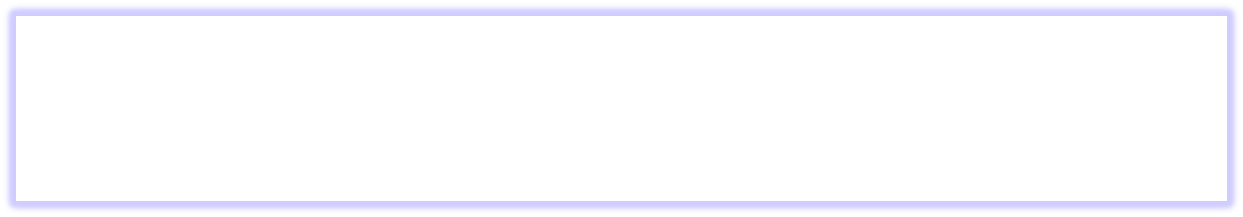




Is Robustness Connected to Cellular Aging in Yeast?
Keyana Scott
Dr. Hong Qin
Biology Department
Introduction
In order to understand the mechanisms of aging as accurately as possible, the organism Saccharomyces Cervisiae was observed because of its similar complex internal cell structure to higher-level eukaryotes In yeast Saccharomyces Cerevisiae, aging is known as replicative life span or RLS; replicative life span is determined by the number of cell divisions that occur prior to senescence (when diploid cells can no longer divide). I studied the effect of robustness on RLS in S. cerevisiae. As a cell’s network robustness decreases, it will be less able to adapt against external perturbations. As a result, functionality of protein activities are depleted; which is the definition of aging. Protein robustness, the ability of a cell to maintain homeostasis, was found to have a positive correlation with RLS, indicating an increased lifespan in prior studies. It is hypothesized that robustness and several different proxies will be directly correlated to replicative life span in Saccharomyces Cerevisiae. The robustness proxies examined are evolutionary distance robustness, morphological plasticity robustness, fitness and the number of genetic interactions robustness. These proxies are a way to measure the robustness in a system.
3
Materials and Methods
4
Results
5
Summary
6
Conclusion
(literature cited)
-To investigate the the

